Slide 1
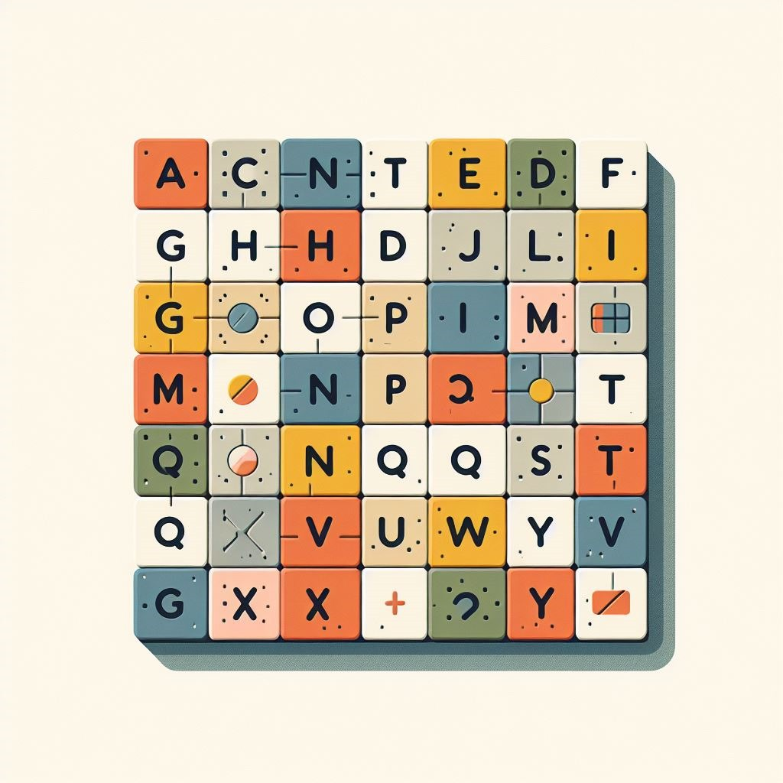
MASTERMIND
Our
video game stimulates the patient's memory by making poses appear on the screen, which the player will have to memorize and reproduce, with the body, according to the legend.
GOALS:
-Stimulate the patient’s memory
-joint rehabilitation

Slide 2
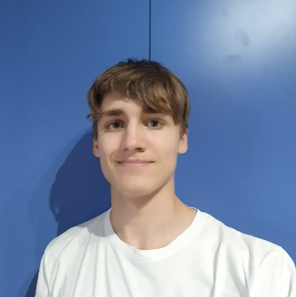
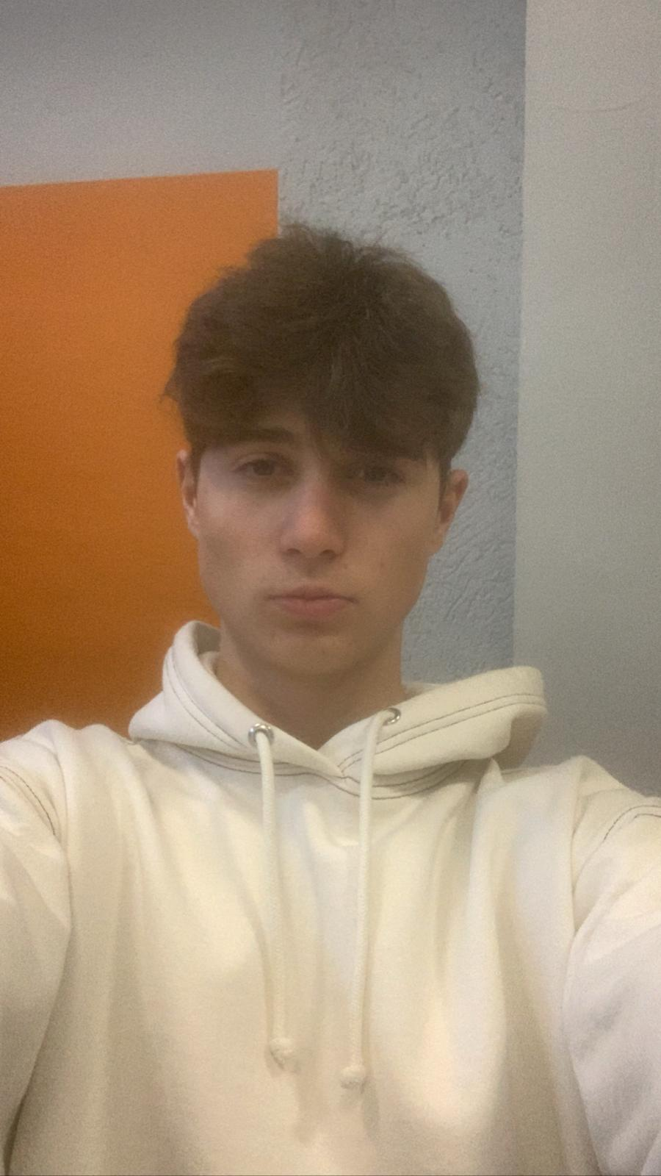
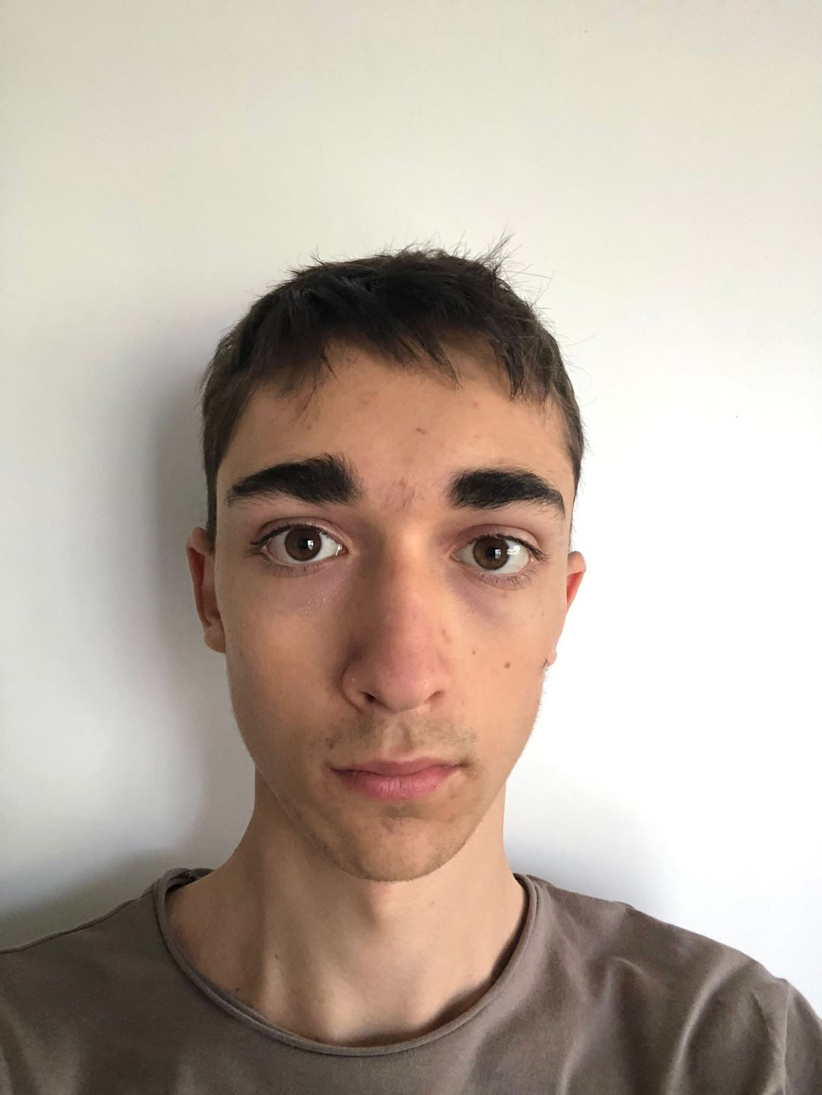
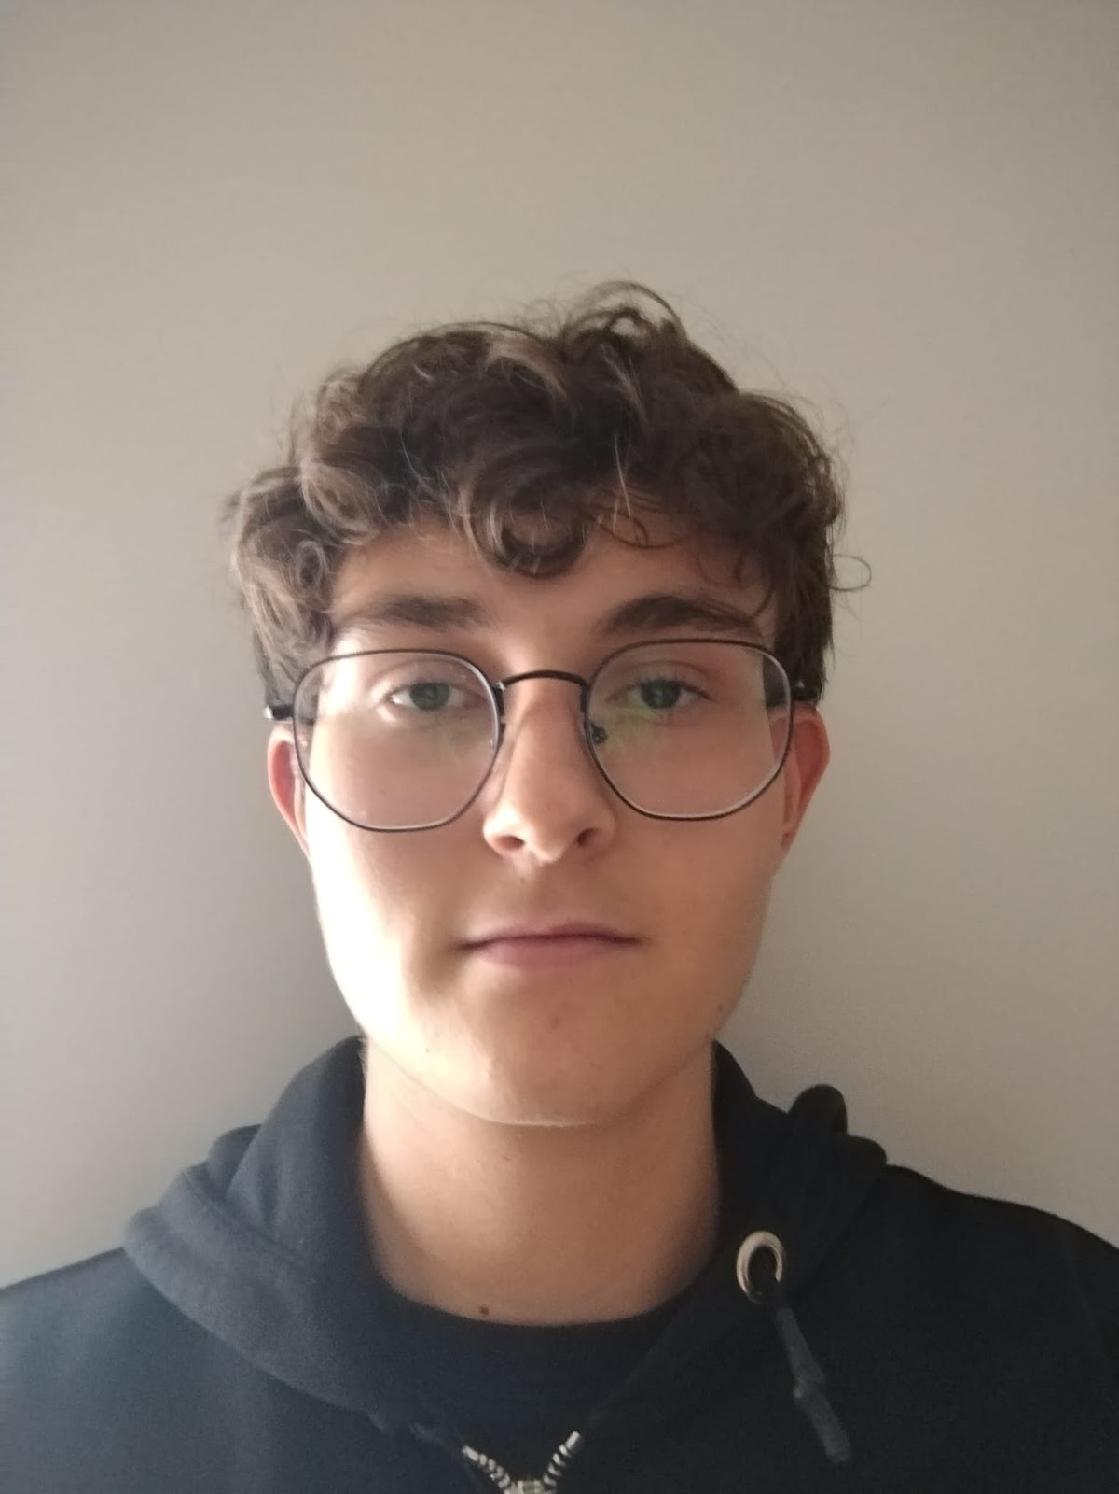
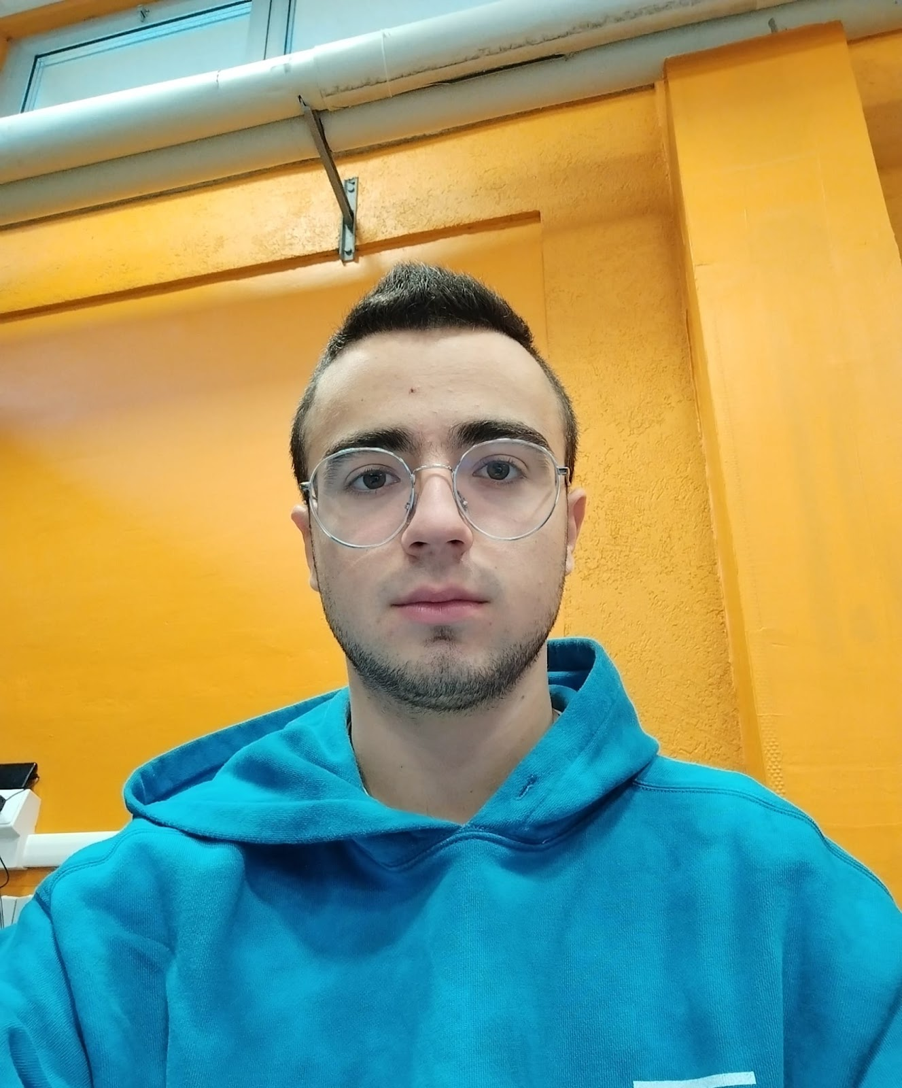
WHO WE ARE?
DAVIDE DELOGU(Developer)
SIMONE NOT(developer)
ALESSANDRO CHIABRERA(developer)
GABRIELE TOMATIS(Team Leader & Designer)
ALBERTO RABBIA(designer)

Slide 3
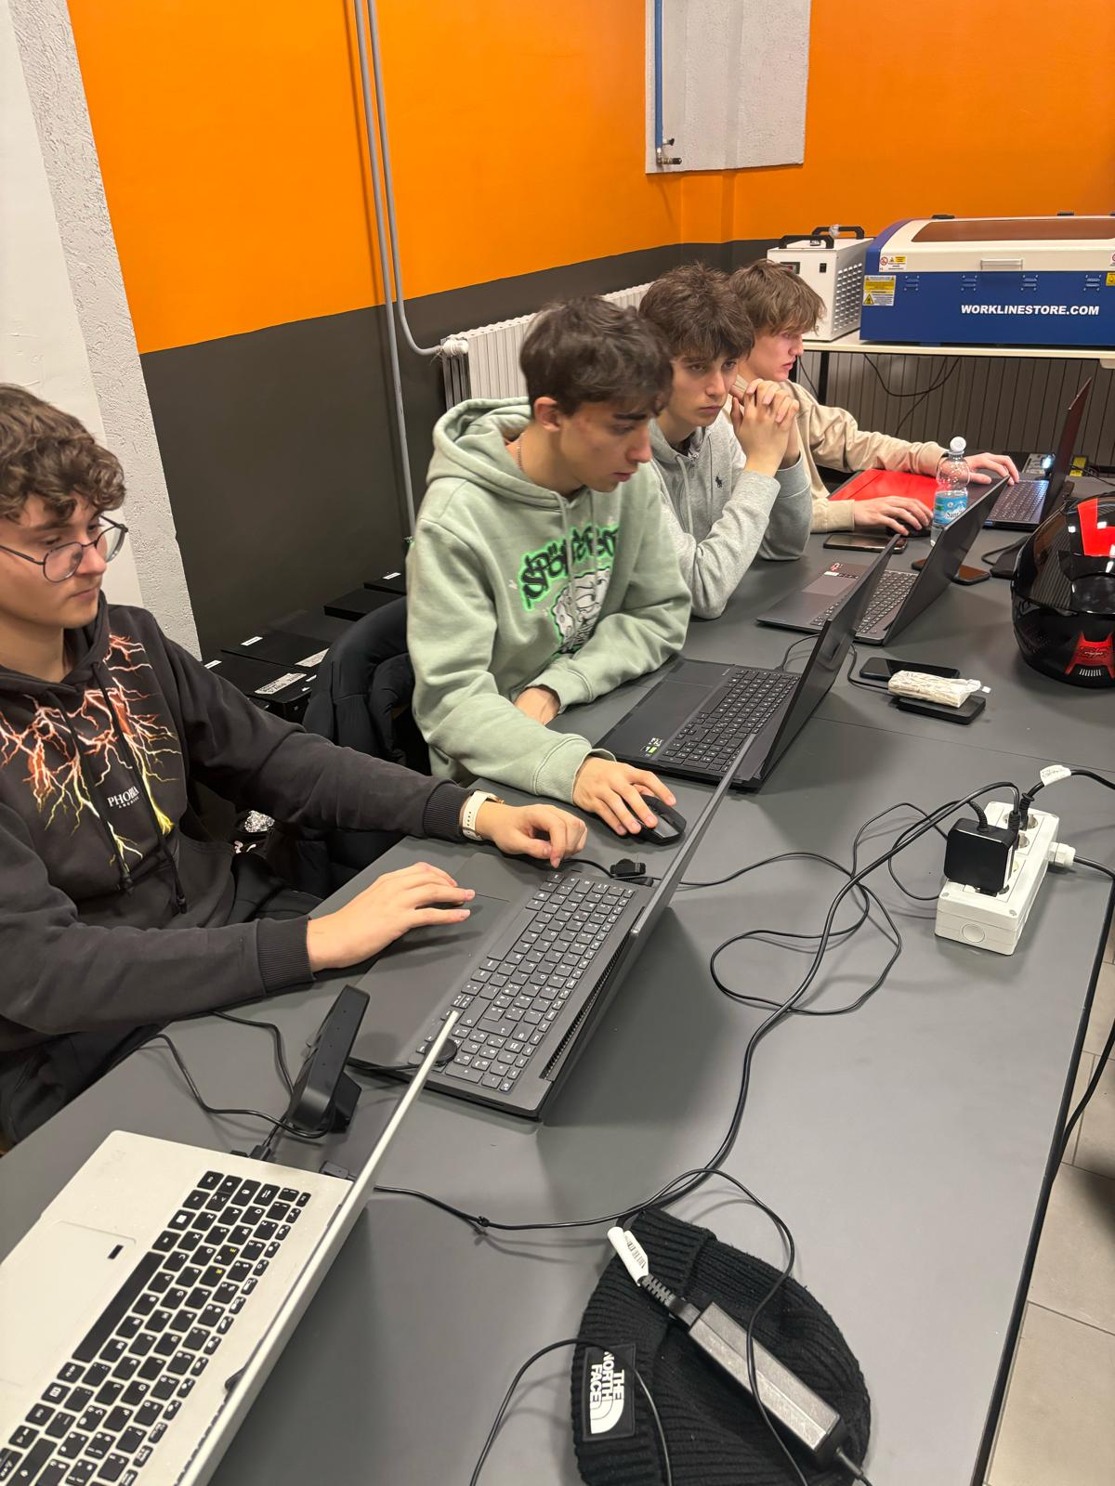
OUR PROJECT
Our project consists of stimulating the patient's memory by using poses to perform those that are useful for stretching the body.
Some of the students within the group programmed some parts of the video game, while others recorded both the video and the audio as well as the presentation and the graphics recording part.

Slide 4
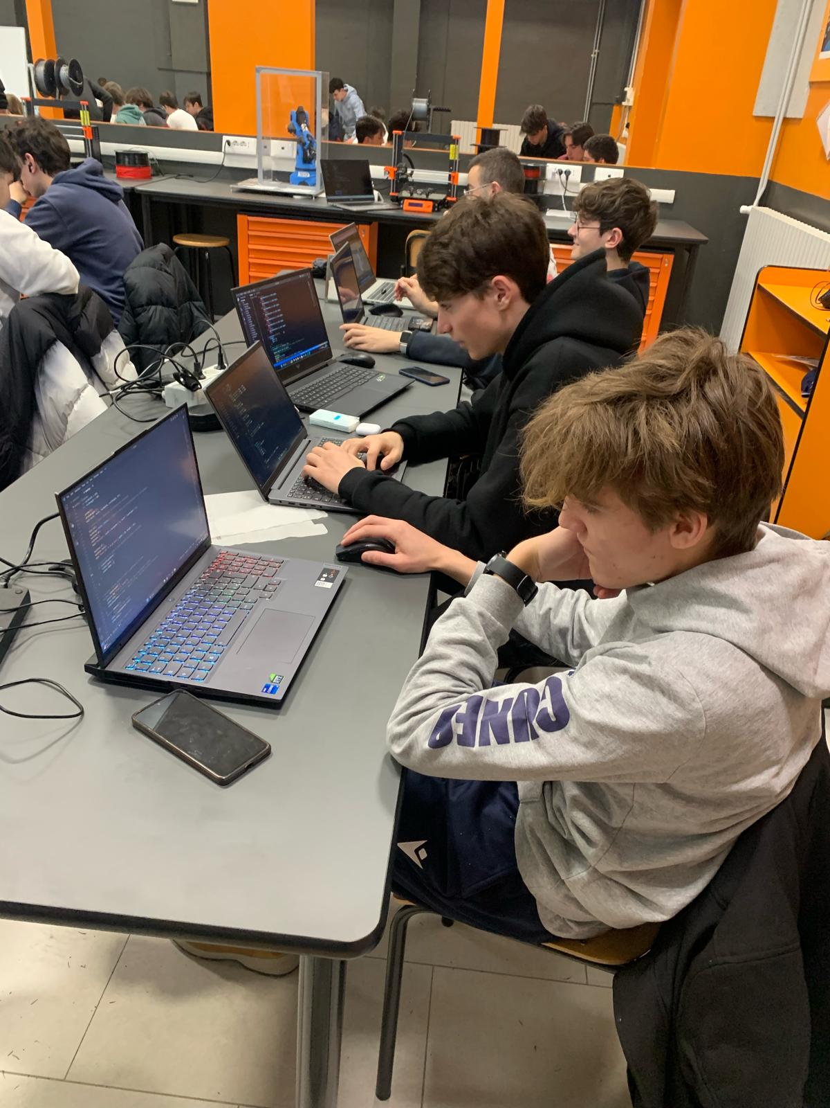
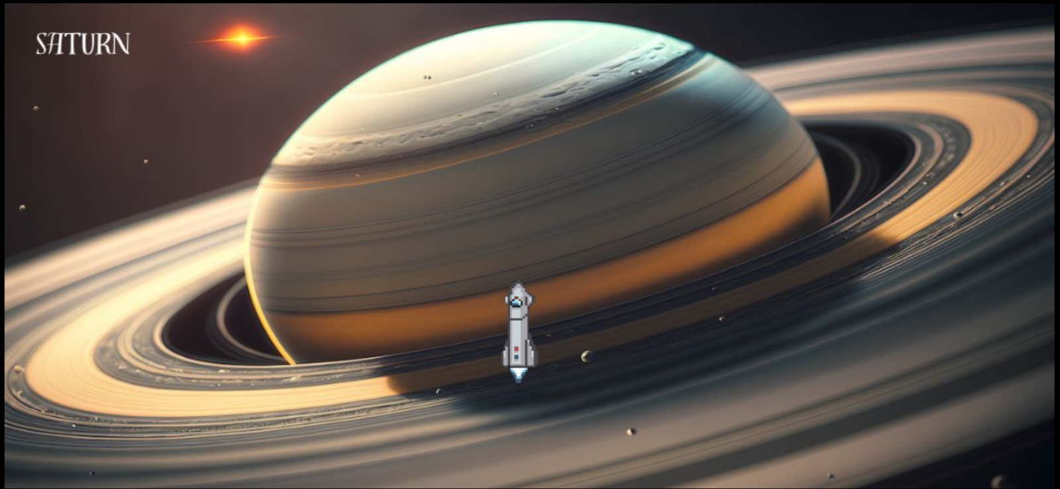
OUR PROJECT
A part of the group started to program in p5, developing the game itself, taking care of the graphics in order to make the video game as complete as possible.
We also developed an idea, that makes the game more interactive, using a small “spaceship” that advances from planet to planet until it lands on Earth moving using the score that player make. Thanks to this device each time the patient points it, he will reach the end of the game and the victory of the player himself/herself.

Slide 5
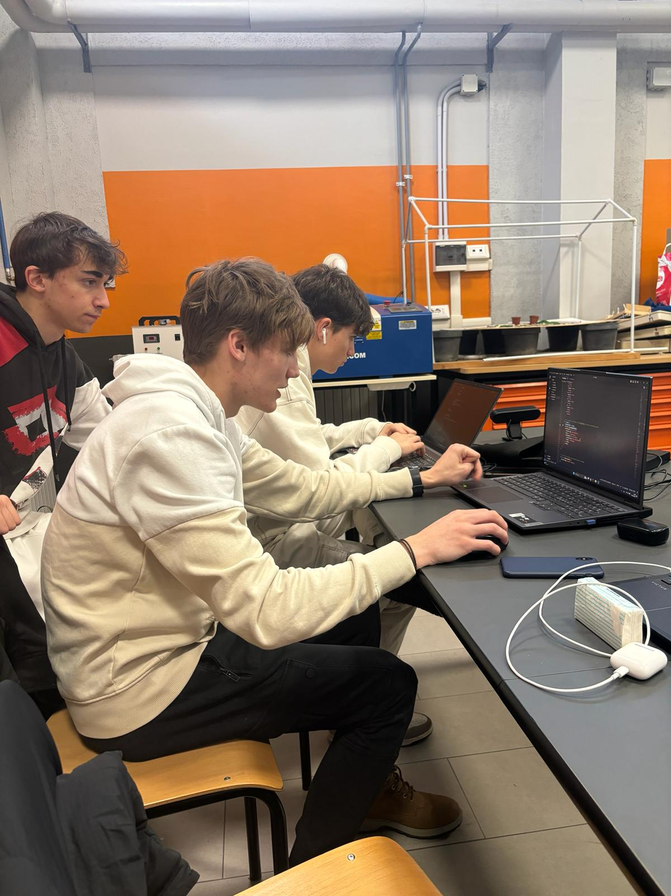
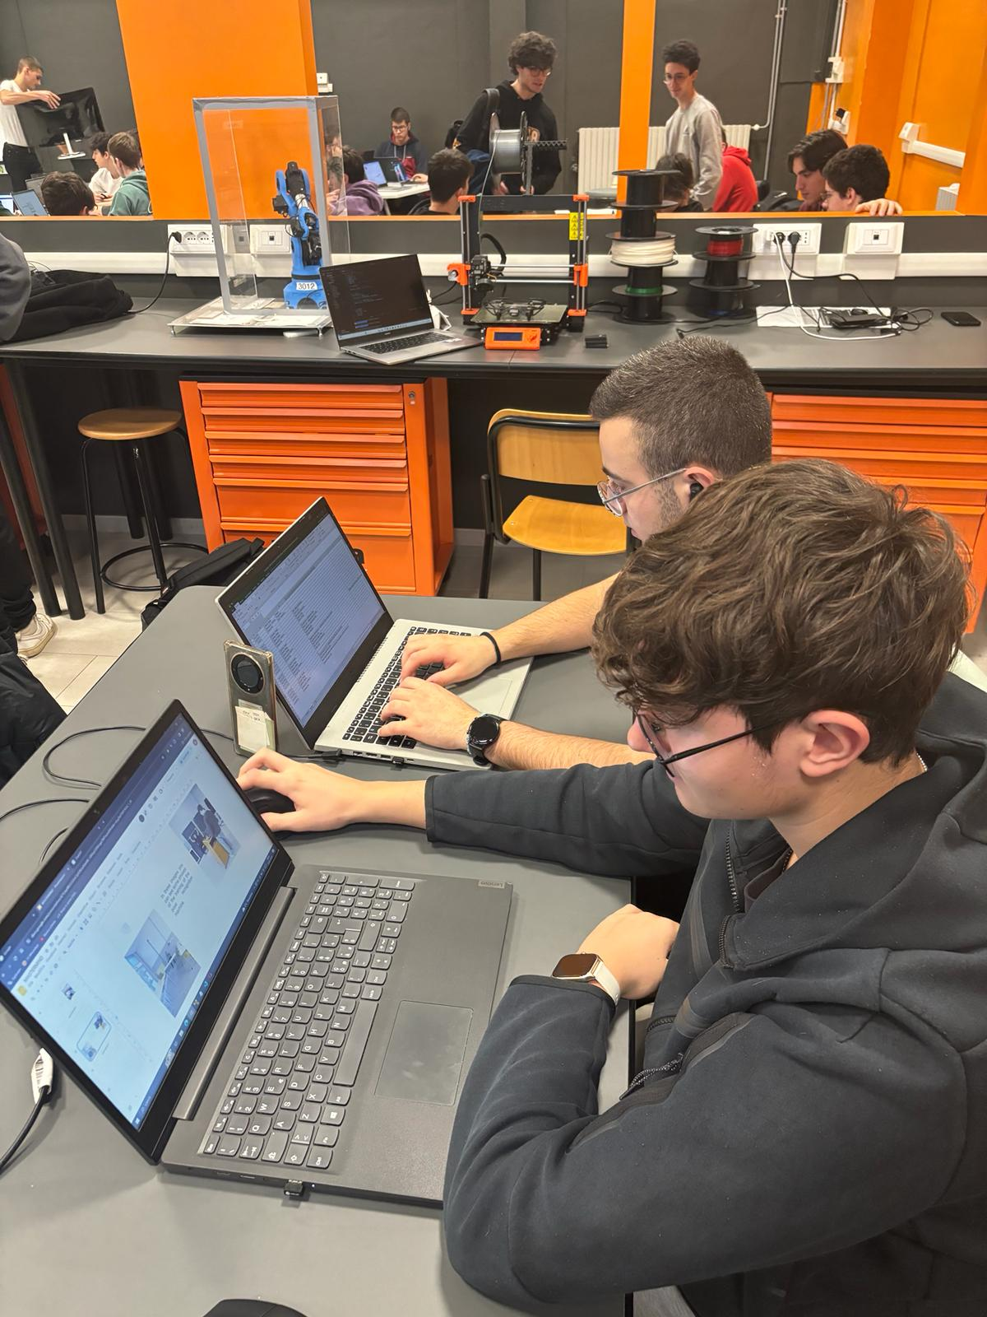
DEVELOPING
In addition, we made tutorials in order to define what were the better poses the players should understand and reproduce so as to increase the motor skills of the patients.
Each tutorial is commented and explained properly, so that the pose to be taken by the player to stretch the body, is more correct and useful to better play the game.
Programmers who develop the game

Slide 6
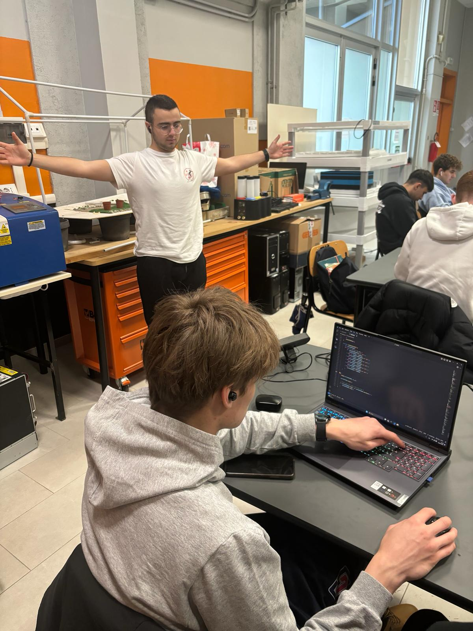
POSE RECOGNITION
A part of the project was realized by training a machine capable of recognizing the movements of the body and assigning the score according to the reproductions of the stretching poses.
After several attempts to find the most effective body recognition method, we decided to use poseNet for motion recognition and not the one that trained through consecutive shots.

Slide 7
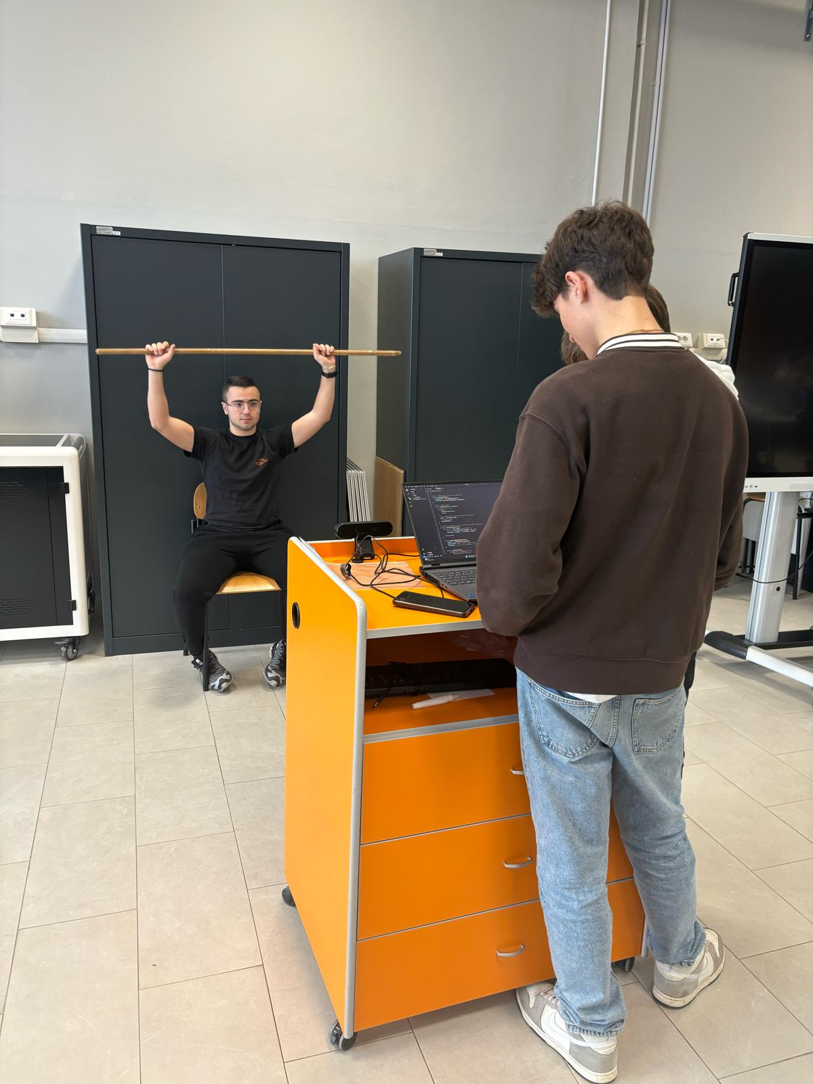
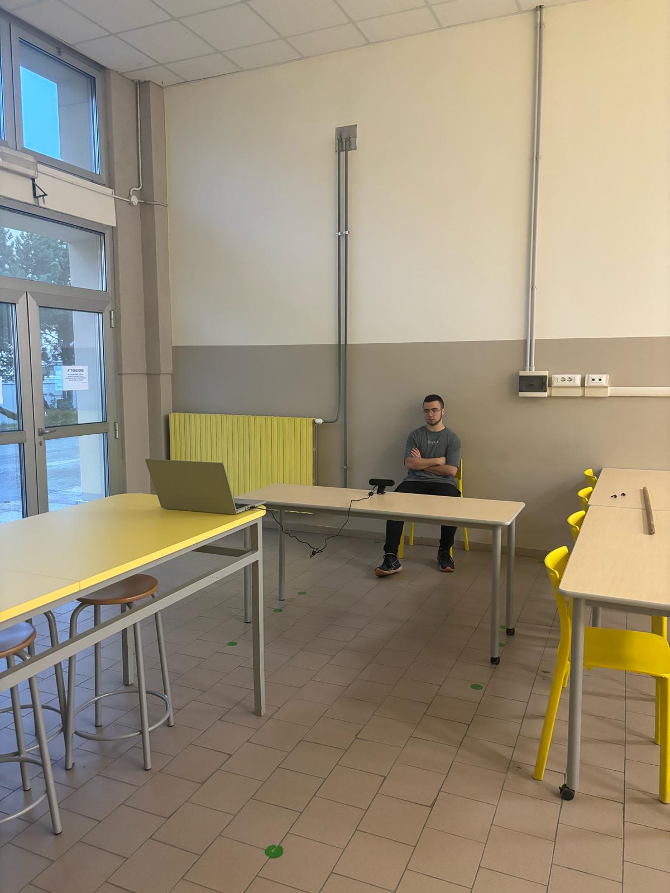
SOME TESTS…
In these images you can see some phases of the training of the pose recognition machine and some test to try the code.

Slide 8
OUR CONSIDERATIONS
To accomplish this project it took about 7 days where we used different techniques to train the pose recognition machine, struggling to figure out which stretching exercises to do for better project operation.
Another difficulty we noticed was that of choosing the project, in fact, on the first day, we thought about many projects to work on, without ever being satisfied, until we found this beautiful thought.
Another difficulty, we found, in writing the code for the random choice of poses, but after several attempts, we were able to solve the various problems.
In spite of everything, we were able to work in a team and develop correctly and completely the project conceived, thanks to work at school and also at home, but above all, thanks to the collaboration of all the team members.
Davide, Alessandro, Simone, Alberto e Gabriele
Immagini prima
slide:generate da microsoft bing

Slide 9
